Slide 1
UNIT-I
ASYMPTOTIC NOTATIONS
Dr. N. Subhash Chandra,
Professor, CVRCE
Source: Web resources and Computer Algorithms by Horowitz, Sahani & Rajasekaran.

Slide 2
Analysis of an Algorithm
The function f(n), gives the running time of an algorithm, depends not only on the size ‘n’ of the input data but also on the particular data. The complexity function f(n) for certain cases are:
1. Best Case : The minimum possible value of f(n) is called the best case.
2. Average Case : The expected value of f(n).
3. Worst Case : The maximum value of f(n) for any key possible input.
Analysis of Algorithms:
The field of computer science, which studies efficiency of algorithms, is known as analysis of algorithms.

Slide 3
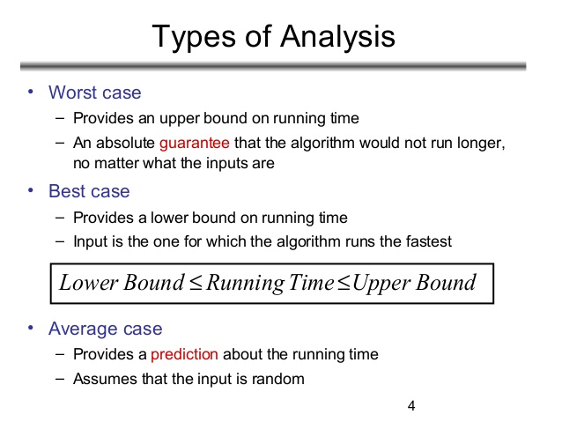
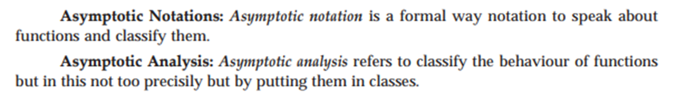
Types of Analysis

Slide 4
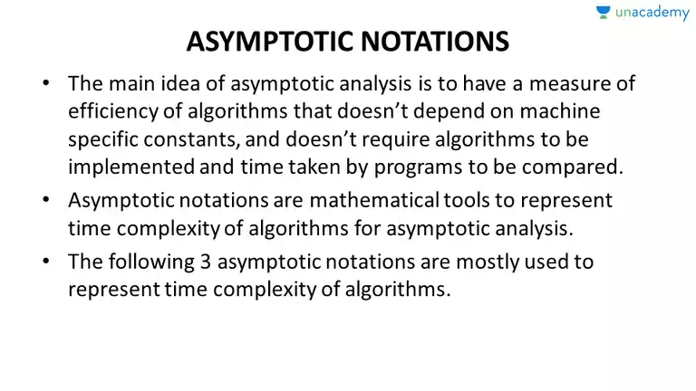
Asymptotic notations
Uses of Notations:
Commonly use notations in performance analysis and used to characterize the complexity of an algorithm:
Big–OH (O)
Big–OMEGA
Big–THETA ()

Slide 5
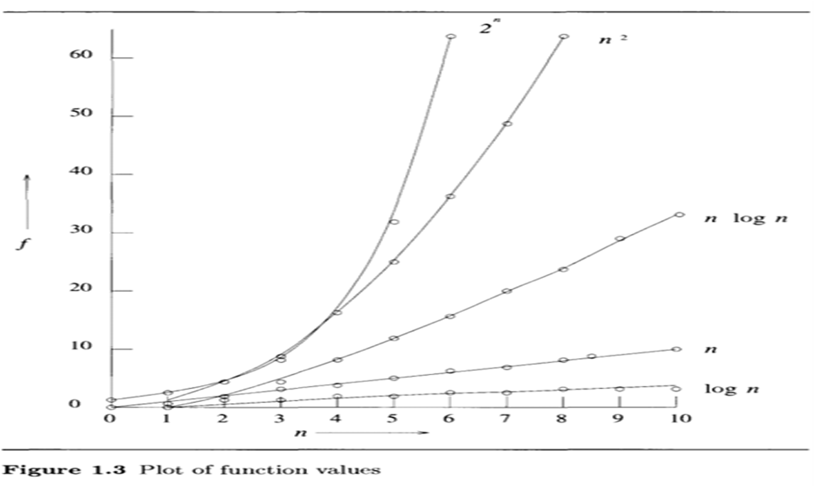
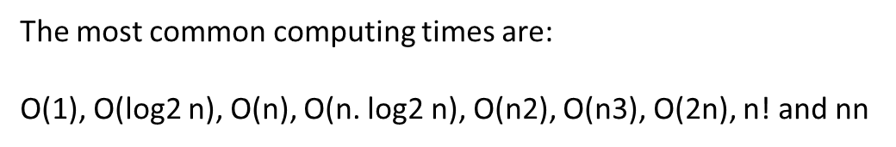
Growth function
Following is a list of some common asymptotic notations:
constant − Ο(1)
logarithmic − Ο(log n)
Linear − Ο(n)
n log n − Ο(n log n)
quadratic − Ο(n2)
cubic − Ο(n3)
Polynomial − Ο(n1)
exponential − Ο(2n)

Slide 6
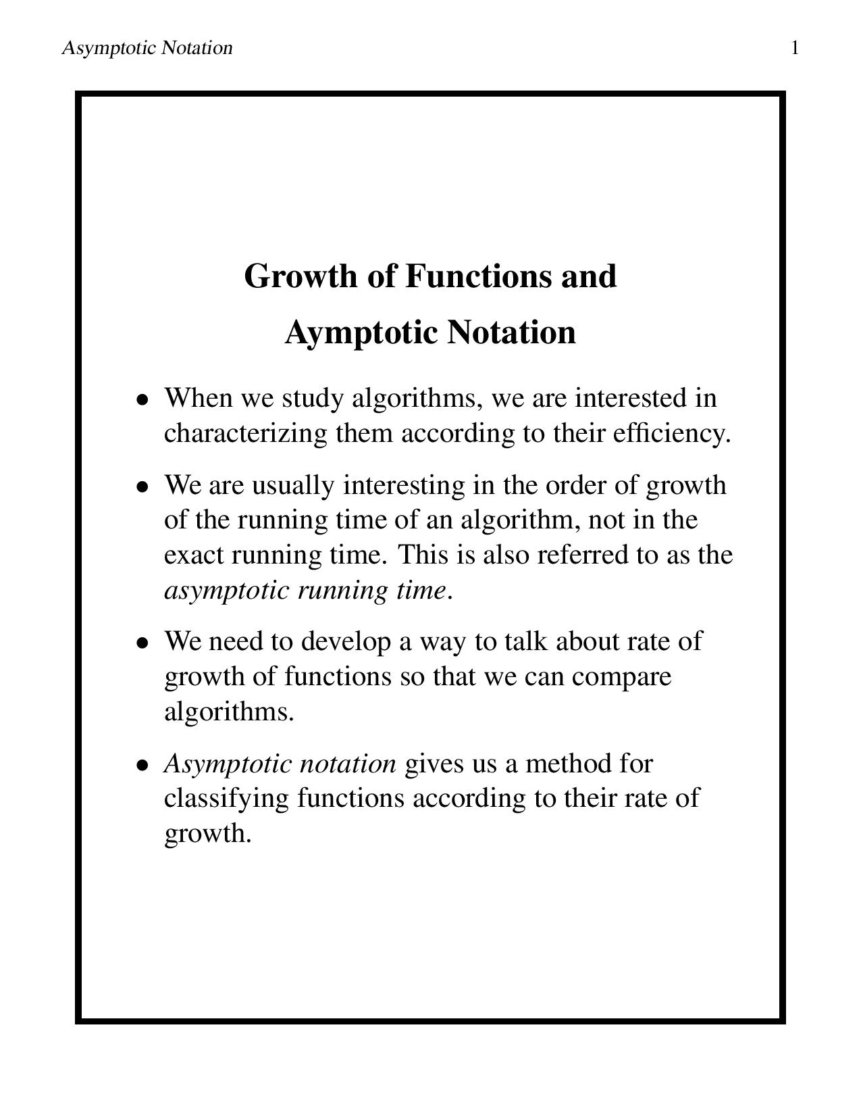
Growth of Function and Asymptotic Notation

Slide 7
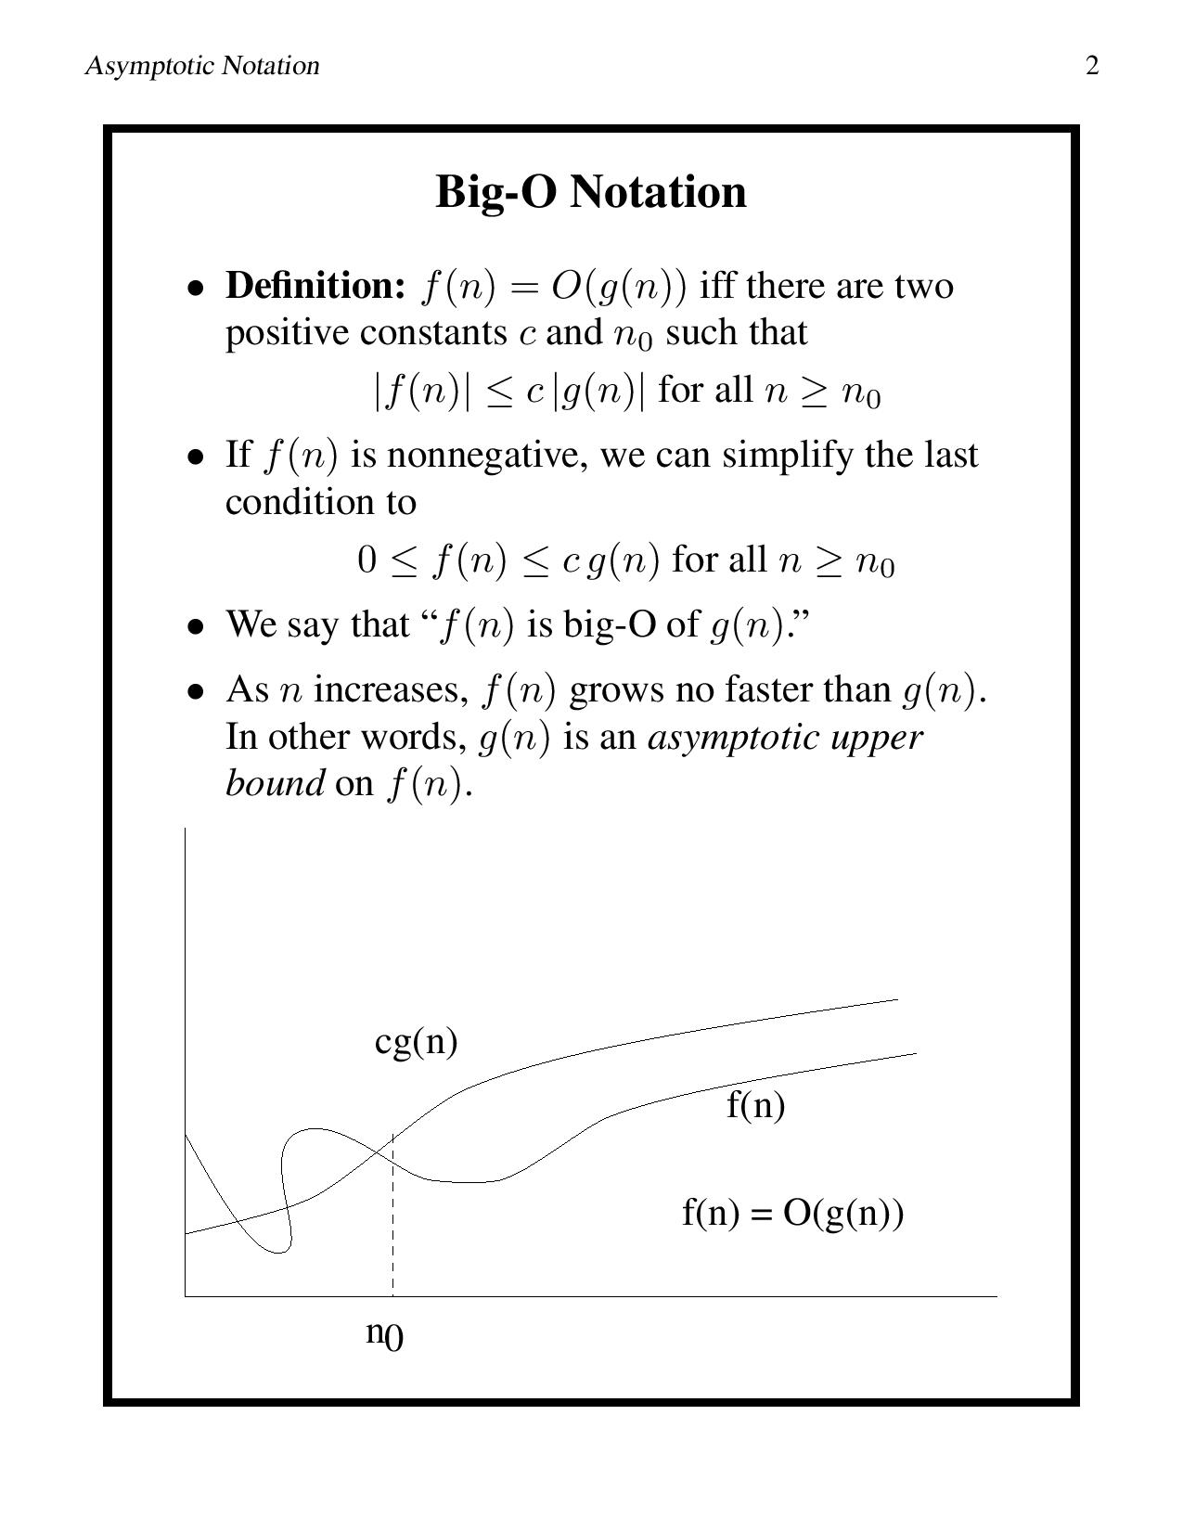
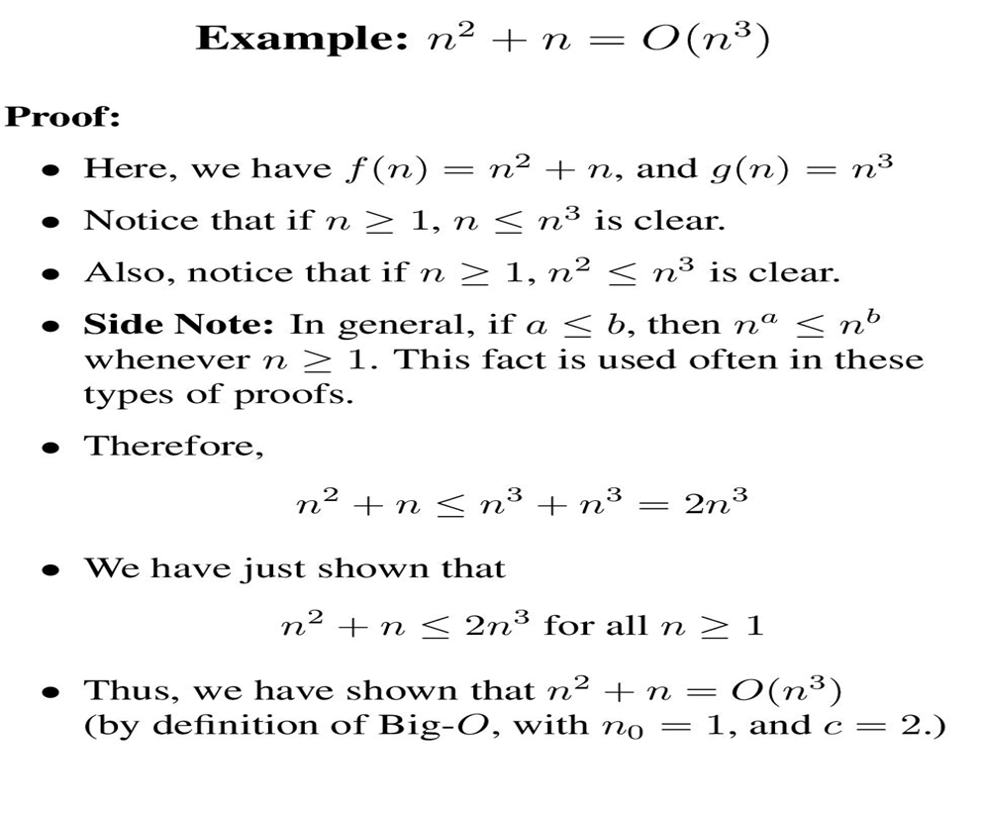
Asymptotic Notation

Slide 8
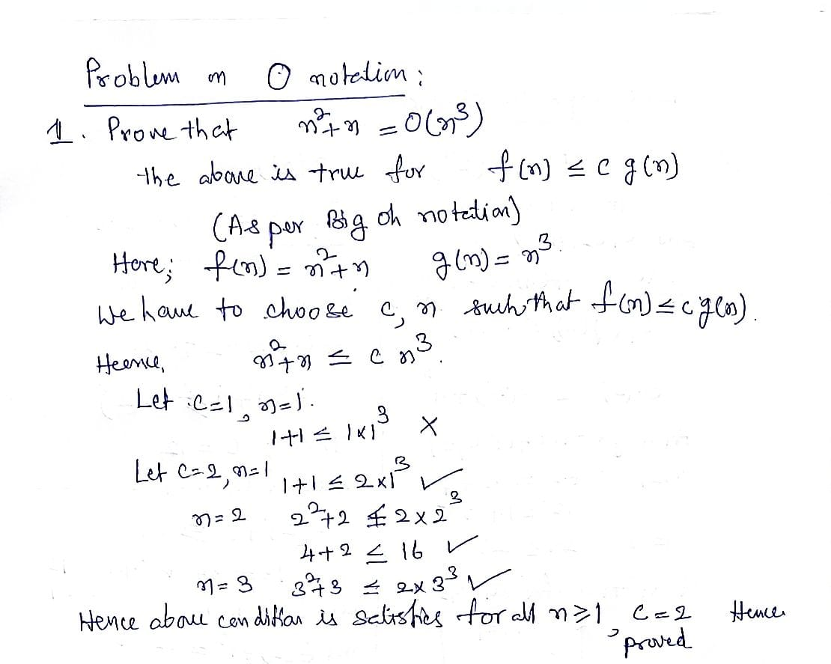
Asymptotic Notation: Example

Slide 9
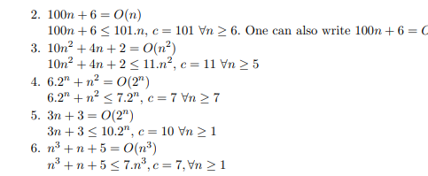
Asymptotic Notation: Problems

Slide 10
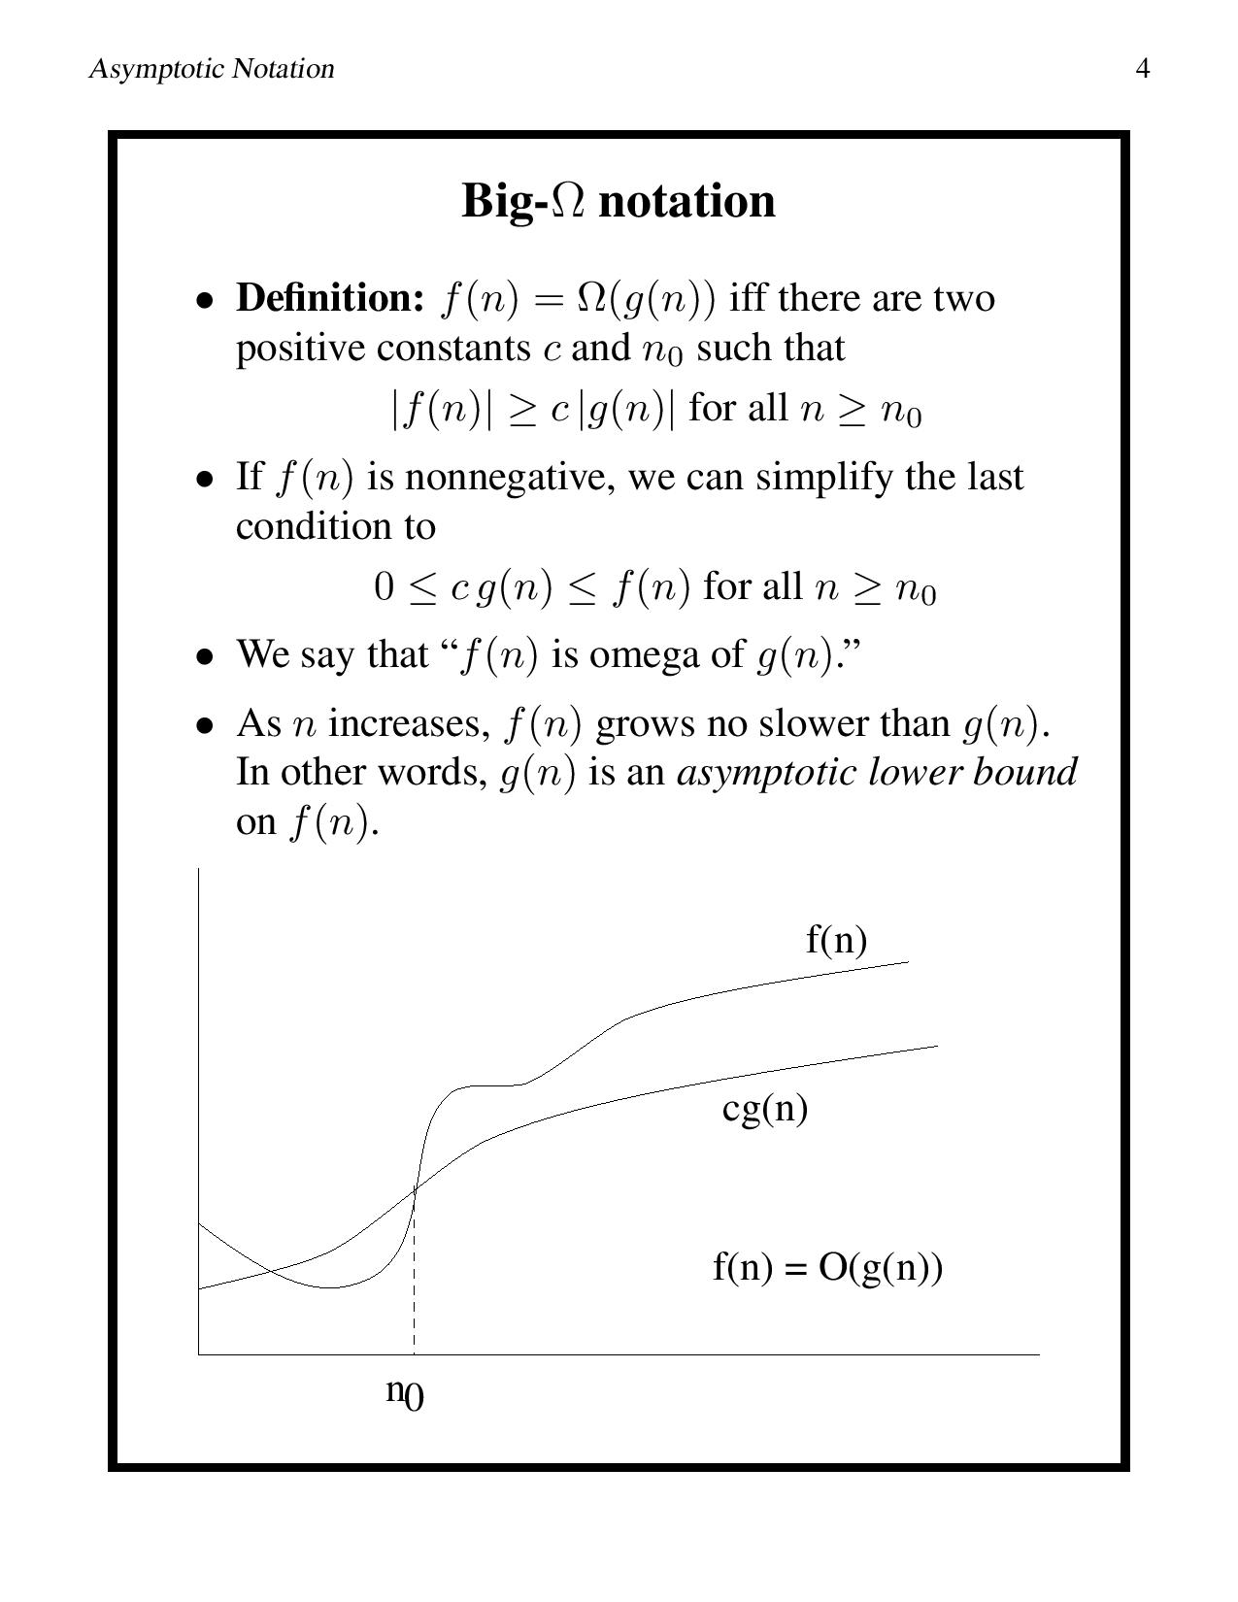
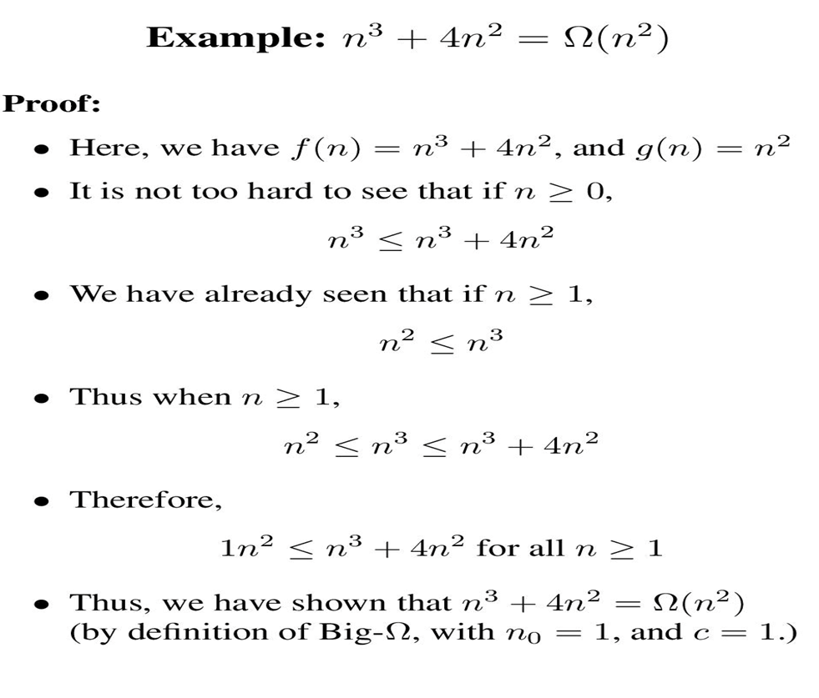
Asymptotic Notation

Slide 11
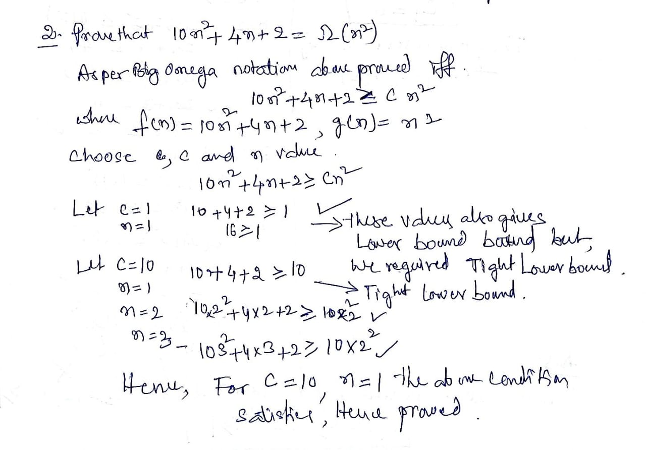
Asymptotic Notation: Example

Slide 12
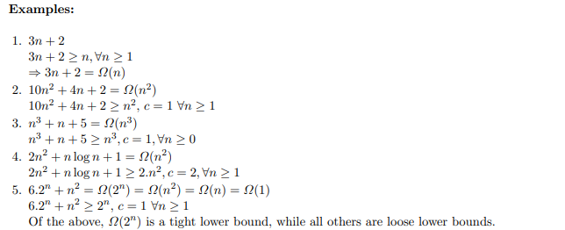
Asymptotic Notation: Example

Slide 13
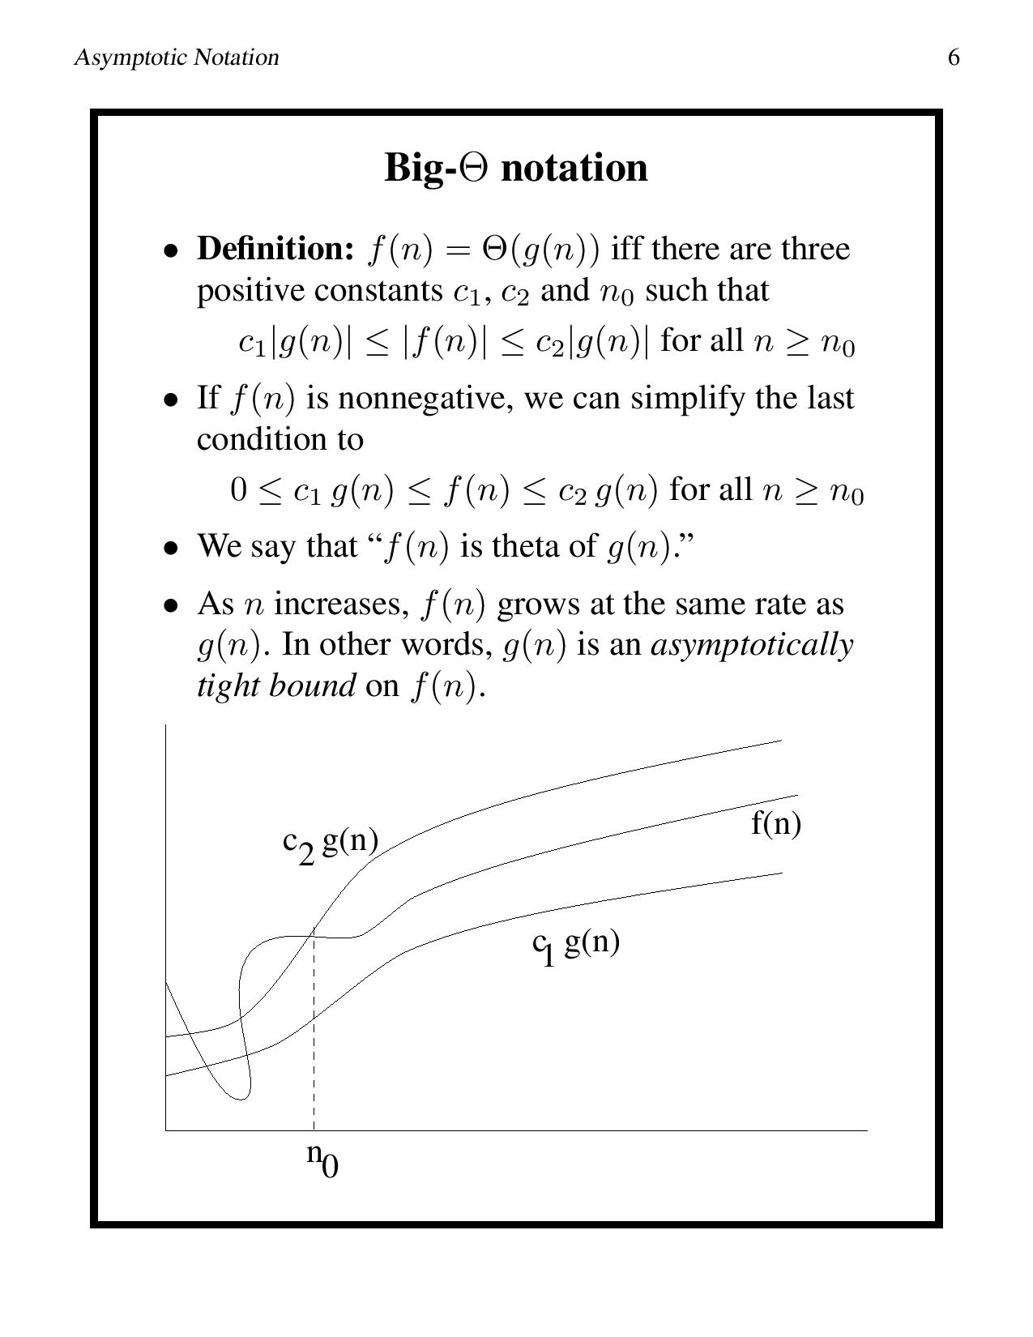
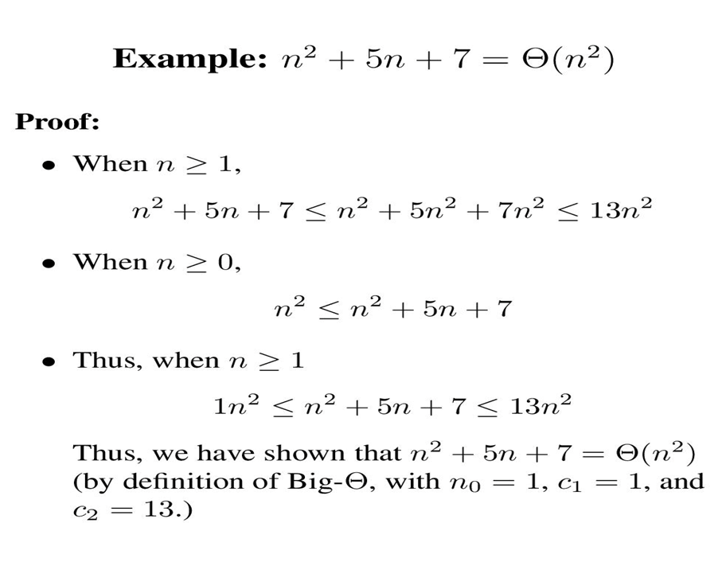
Asymptotic Notation

Slide 14
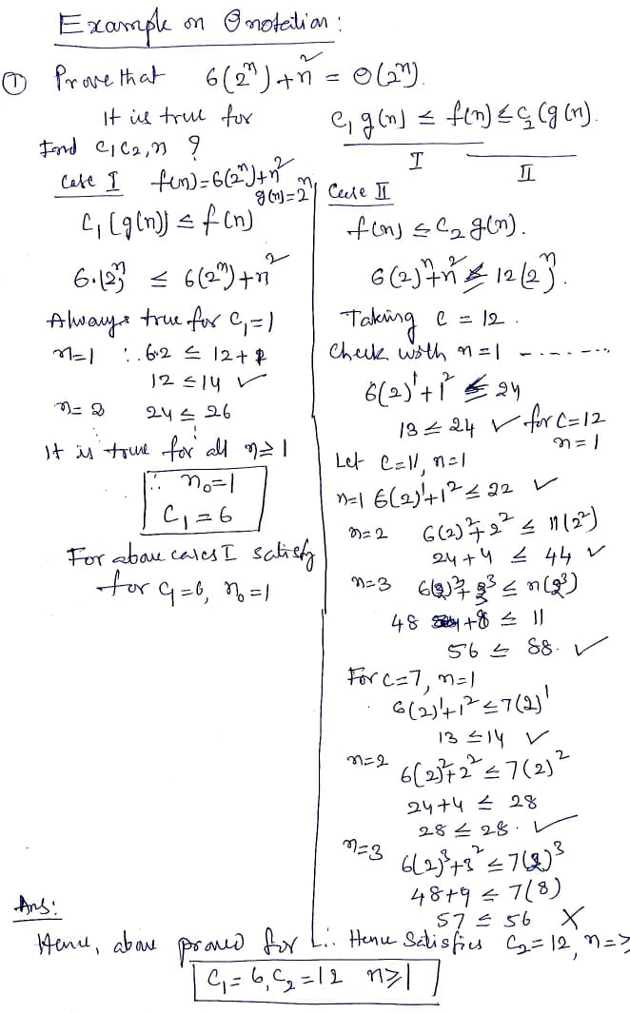
Asymptotic Notation: Example

Slide 15
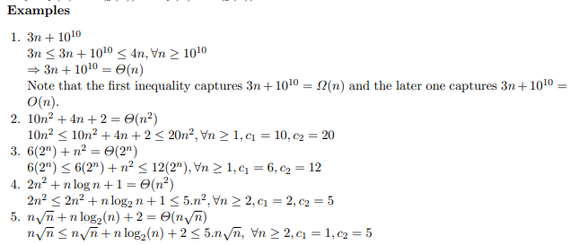
Asymptotic Notation: Example

Slide 16
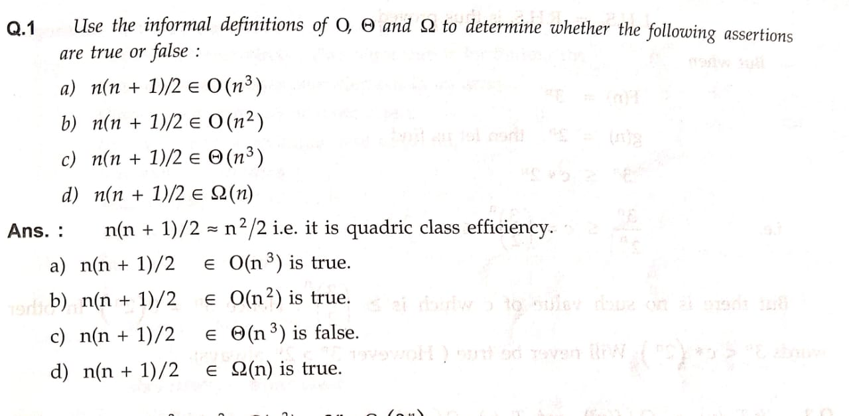
Asymptotic Notation

Slide 18
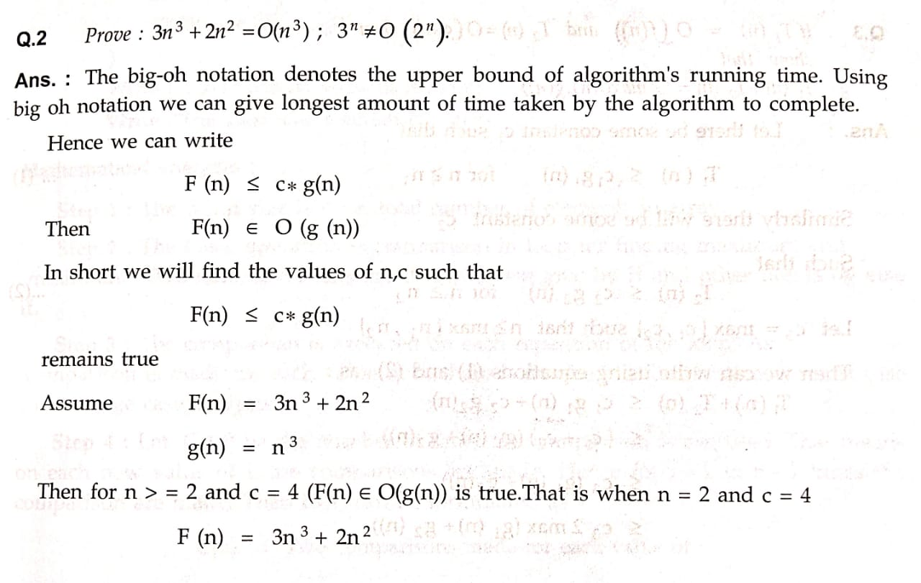
Asymptotic Notation

Slide 19
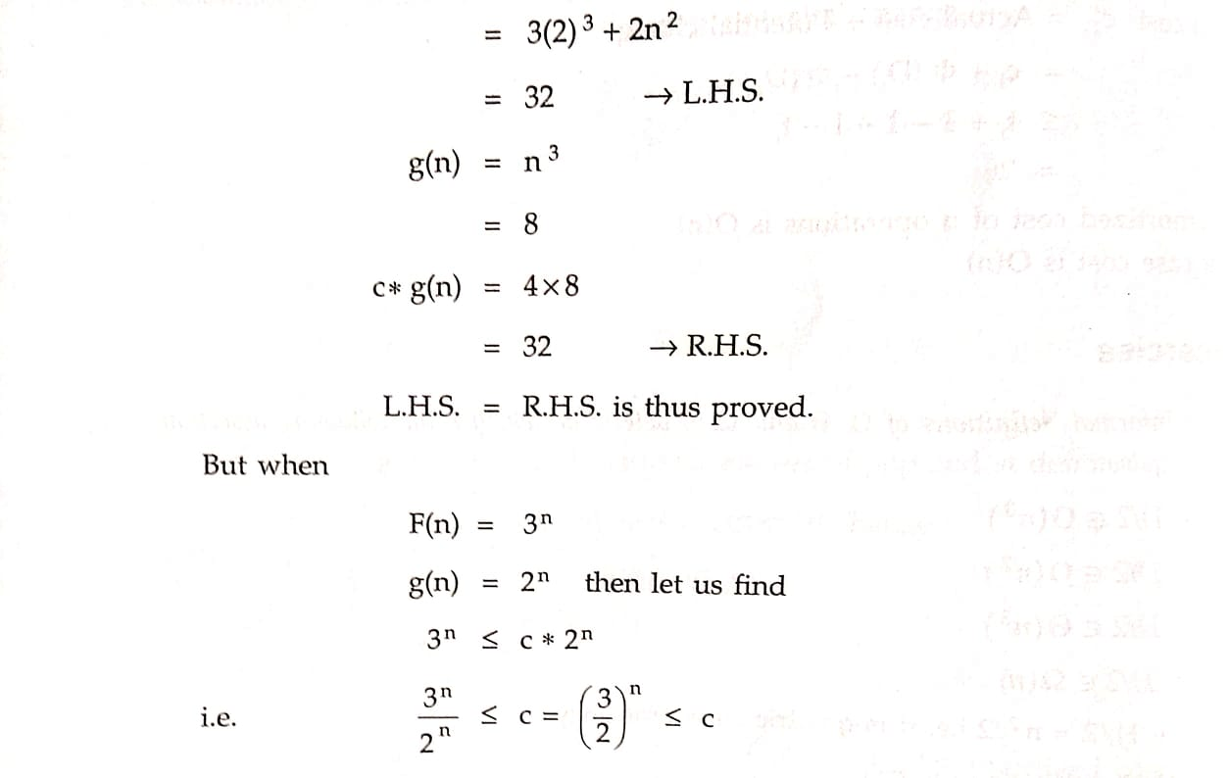
Asymptotic Notation

Slide 20
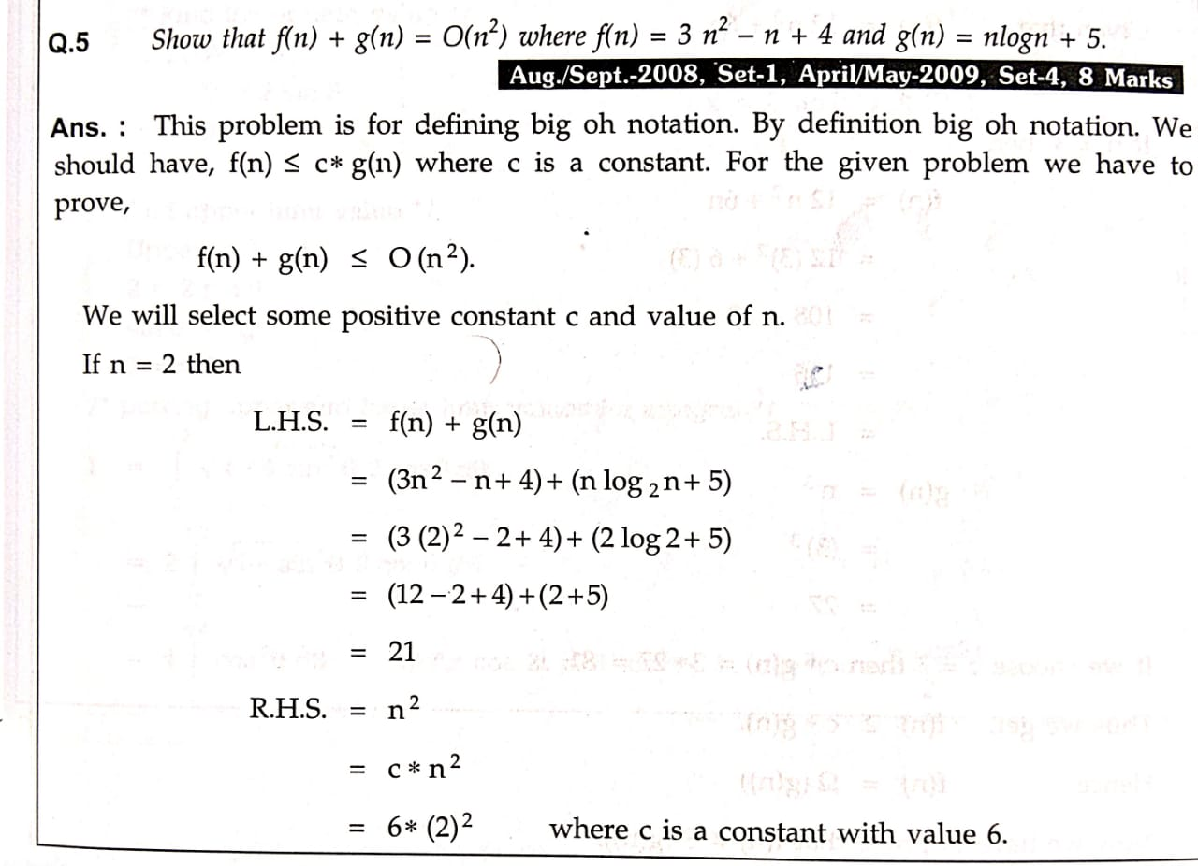
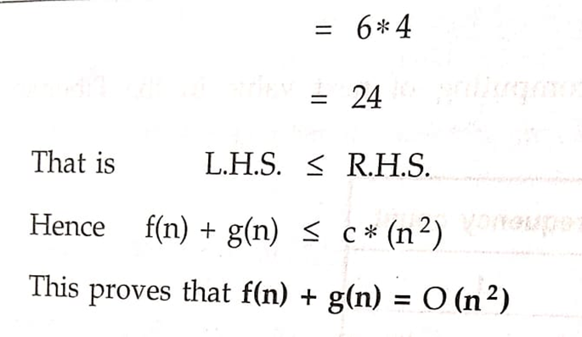
Asymptotic Notation

Slide 21
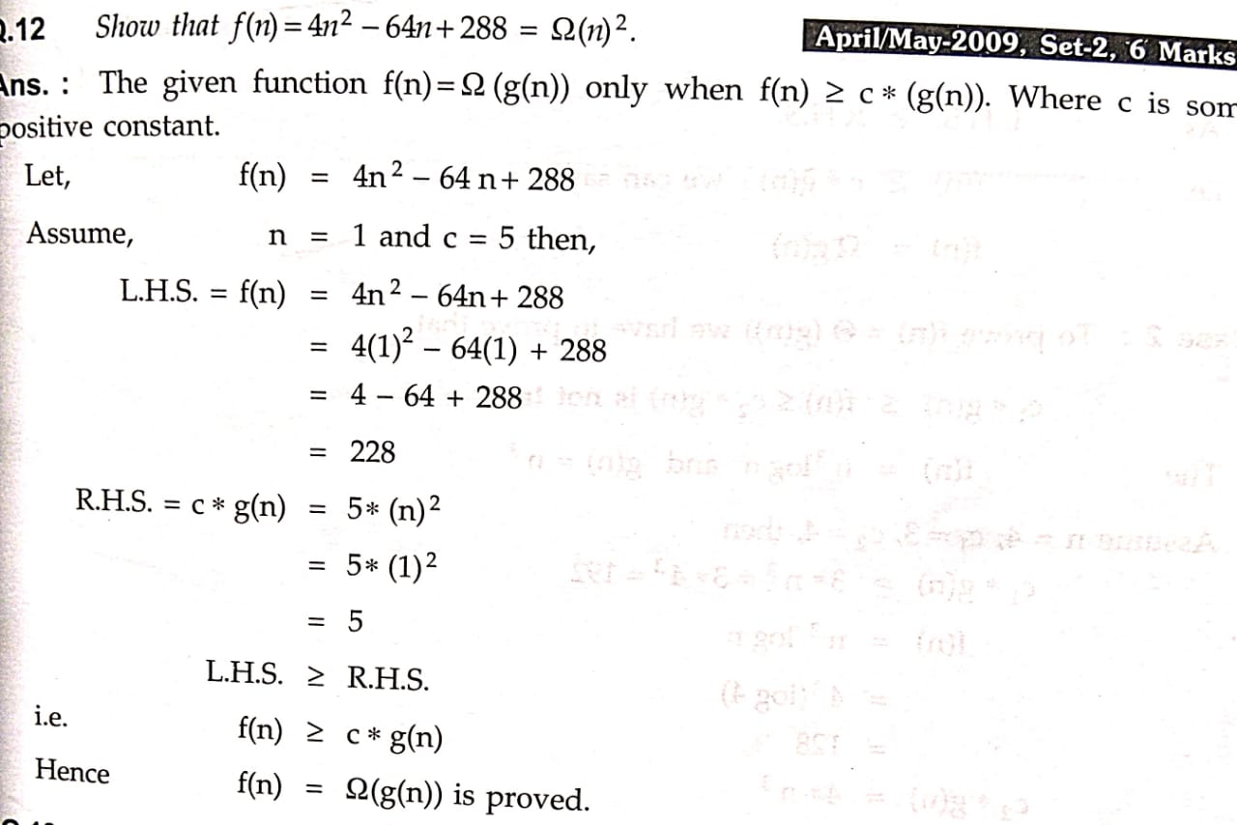
Asymptotic Notation

Slide 22
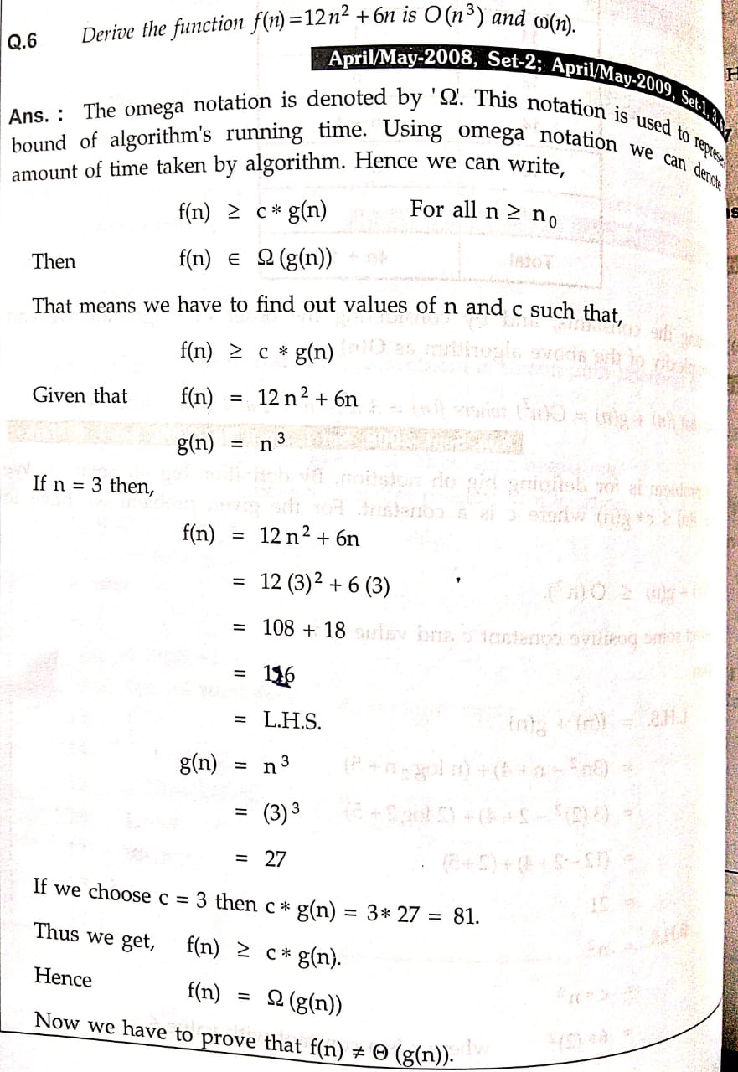
Asymptotic Notation

Slide 23
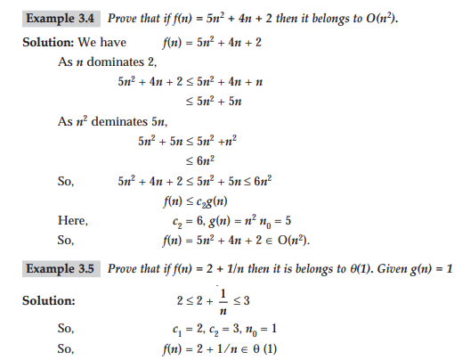
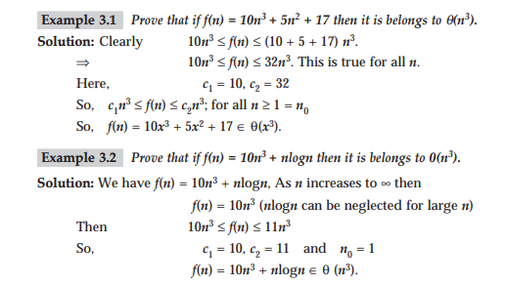
Examples

Slide 24
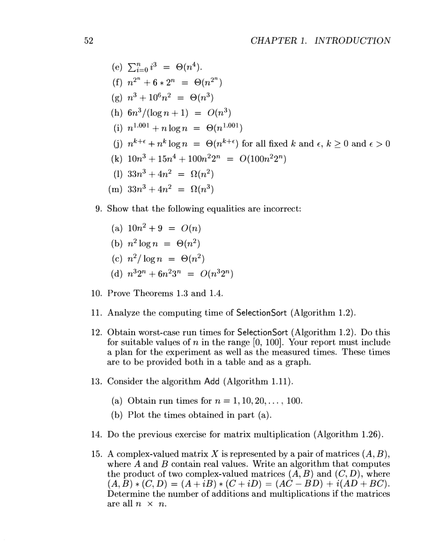
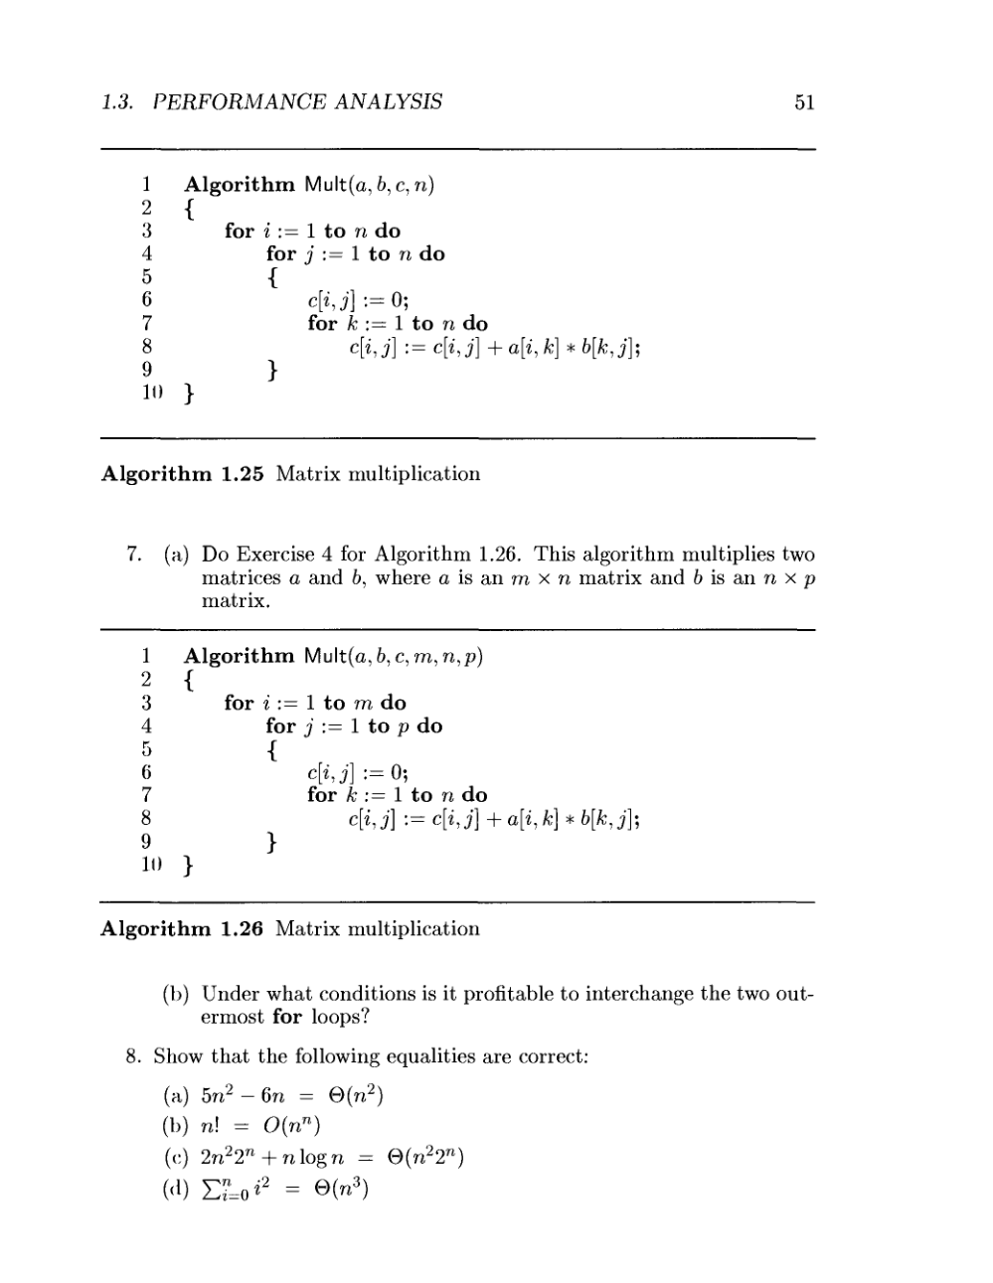
Problems on Asymptotic Notations

Slide 25
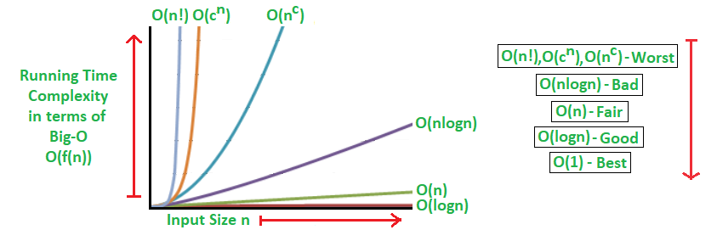
Types time complexities in terms of Big O

Slide 26
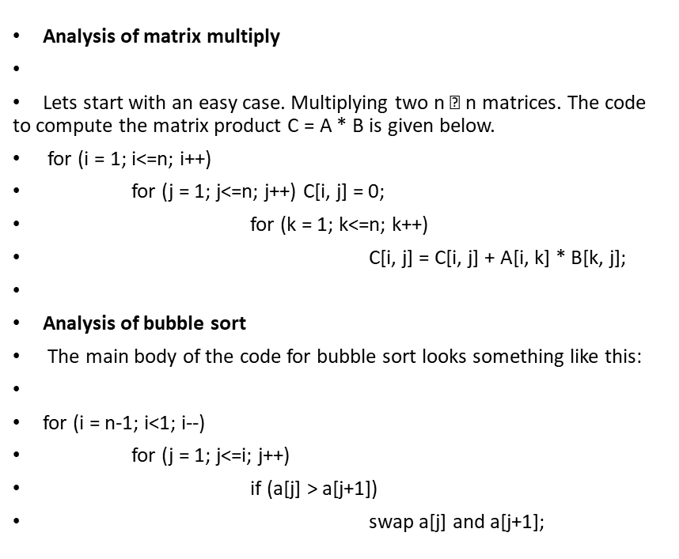
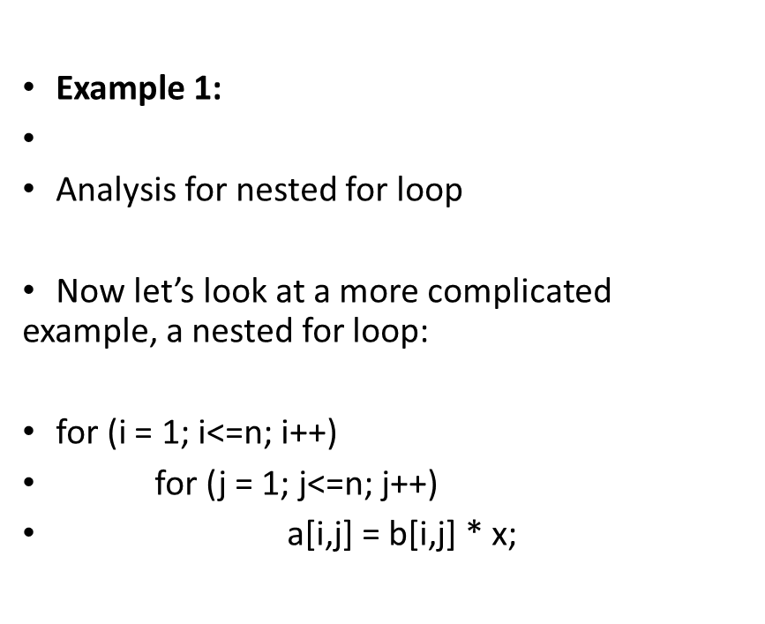
Examples for Time complexities

Slide 27
General rules for the analysis of an Algorithm
The running time of each assignment read and write statement can usually be taken to be O(1).
The largest running time of any statement in the sequence.
The time to execute a loop is the sum, over all times around the loop, the time to execute the body and the time to evaluate the condition for termination
The running time of an if-statement is the cost of conditionally executed statements, plus the time for evaluating the condition. The time to evaluate the condition is normally O(1)

Slide 28
General rules for the analysis of an Algorithm
Analyse for worst case scenario .
Rule 1: For large polynomial, Drop Lower order term, Drop Constant multiplier.
Rule 2: Total running time equal to sum of running time of all segments.
Rule 3: For Conditional statement , Pick complexity of condition which is worst case
Rule 4: The time hierarchy of complexities
O(1)<O(logn)<O(n)<O(nlogn) <O(n²) <O(n³)< --------O(2^{n})< O(n!)< O(n^{n})

Slide 29
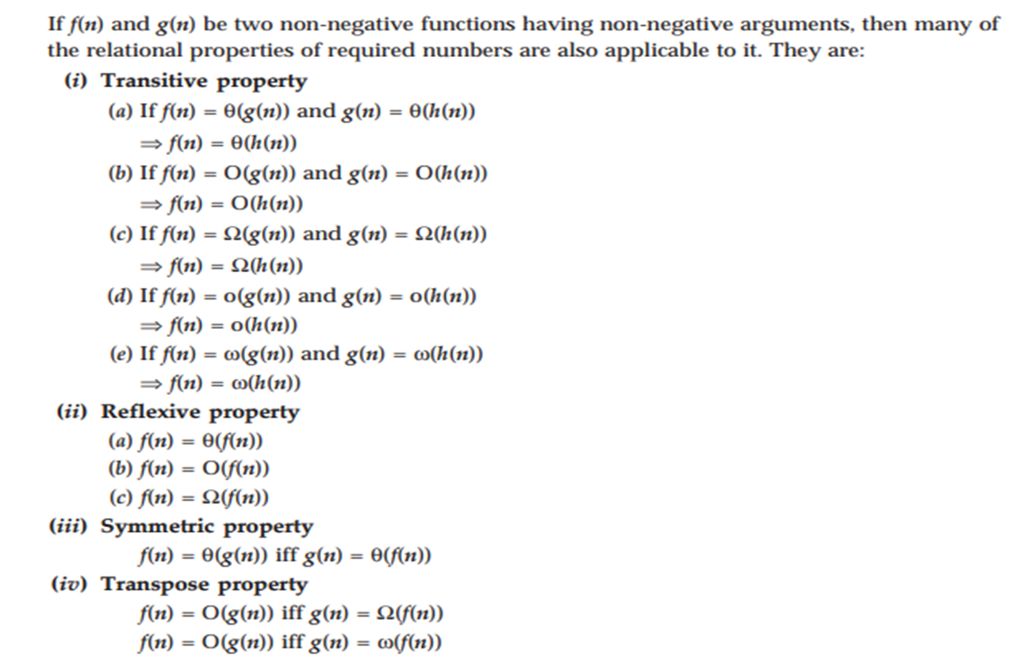
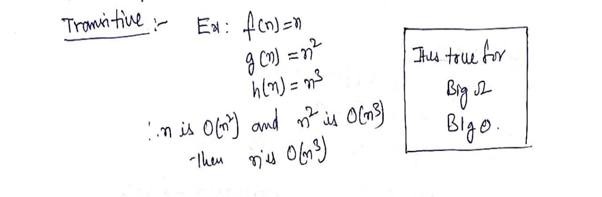
Properties of Asymptotic notations

Slide 30
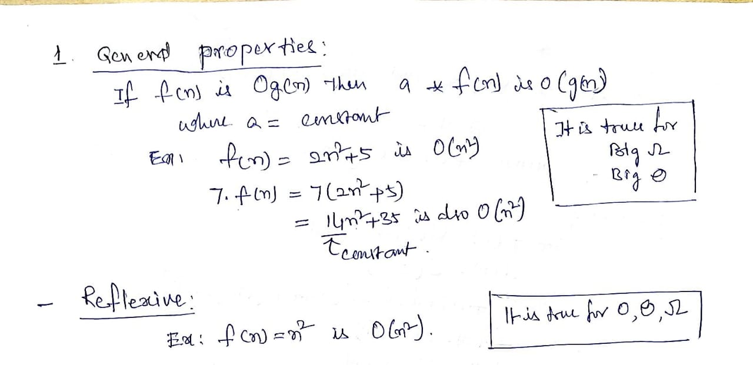
Properties of Asymptotic notations

Slide 31
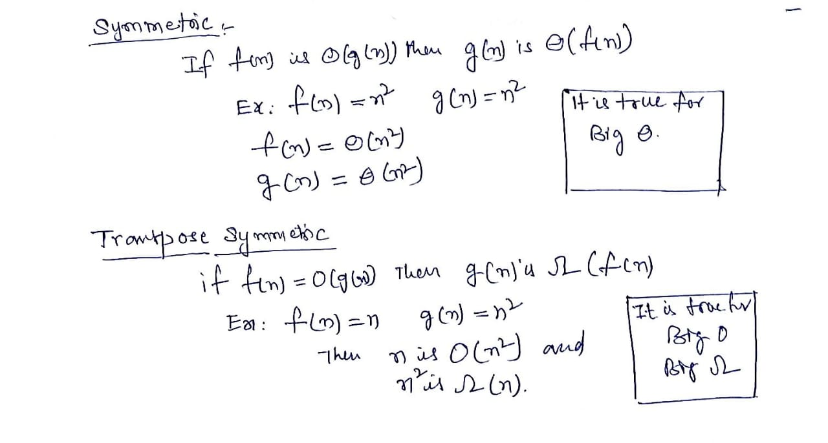
Properties of Asymptotic notations

Slide 32
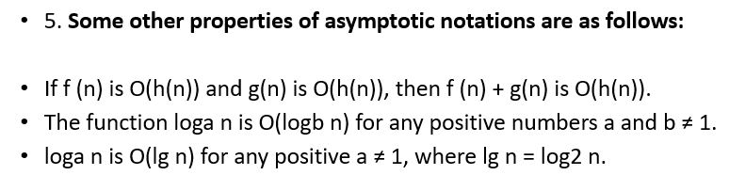
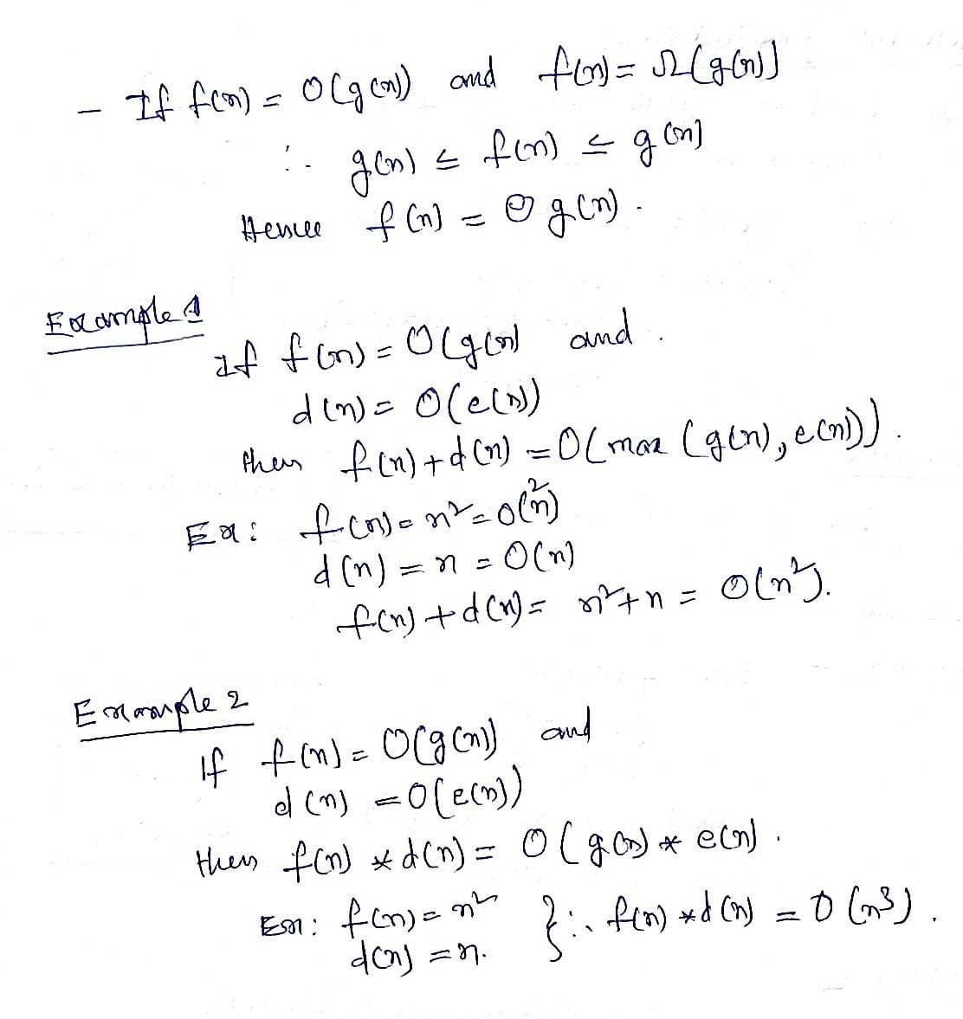
Properties of Asymptotic notations

